Slide 1

Payroll Liquid Hub
Guided Learning Kit
Payroll UI Navigation

Slide 2
Payroll UI Navigation
In this guided learning kit, you will be able to:
Learn the basic pages of Oracle HCM Cloud Payroll
Learn the functionality behind the action links and key tasks associated with Payroll
Learn to navigate the pages within Payroll
Guided Learning Kit

Slide 3
Payroll UI Navigation
Learning Catalog:
HCM Cloud Login Page
Areas/regions in the responsive UI pages of Payroll
Person Information
Payroll Relationship
Third-Party Person Payment Methods
Element Entries
Calculation Cards
Adjust Individual Balance
Flow Submission and Results
Simplified QuickPay
Person Results
Submit a Flow
View Flows
Payroll Dashboard
Administration
Object Groups
Payroll Flow Patterns
Organization Payment Methods Flows
Payroll Dashboard
Guided Learning Kit

Slide 4
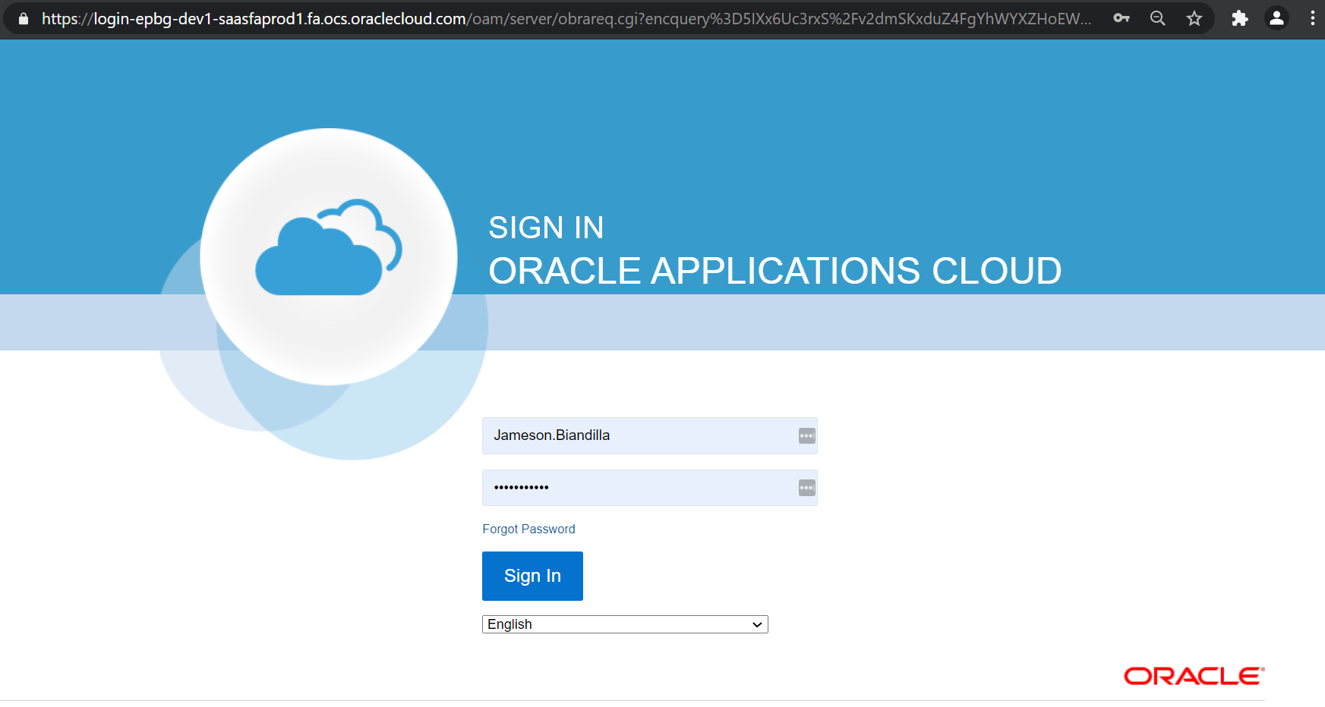
Payroll UI Navigation
Login to HCM Cloud pod by entering your username and password. Click Sign In button to proceed.
Guided Learning Kit
Back to Catalog

Slide 5
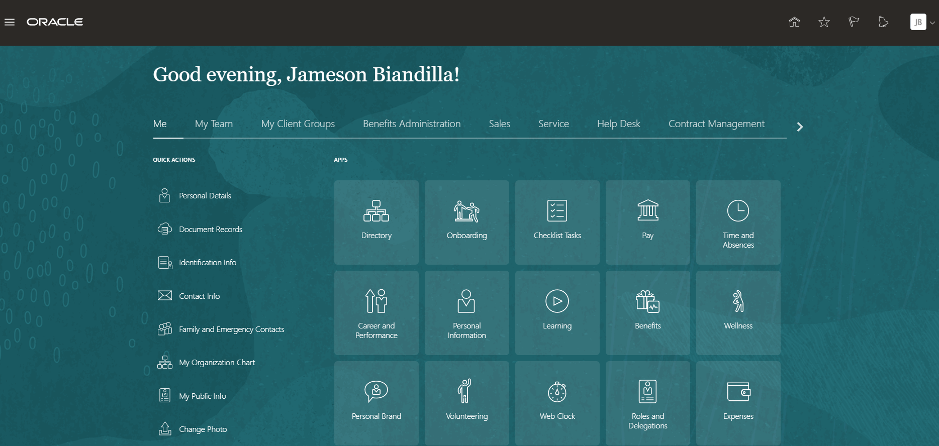
Payroll UI Navigation
This is the default Home page of HCM Cloud
You can always click Home button to go back to default page.
Guided Learning Kit
Next

Slide 6
Payroll UI Navigation
1
To see payroll-related tasks and configurations,
1 Click My Client Groups
2 Click Payroll
Guided Learning Kit
Back

Slide 7
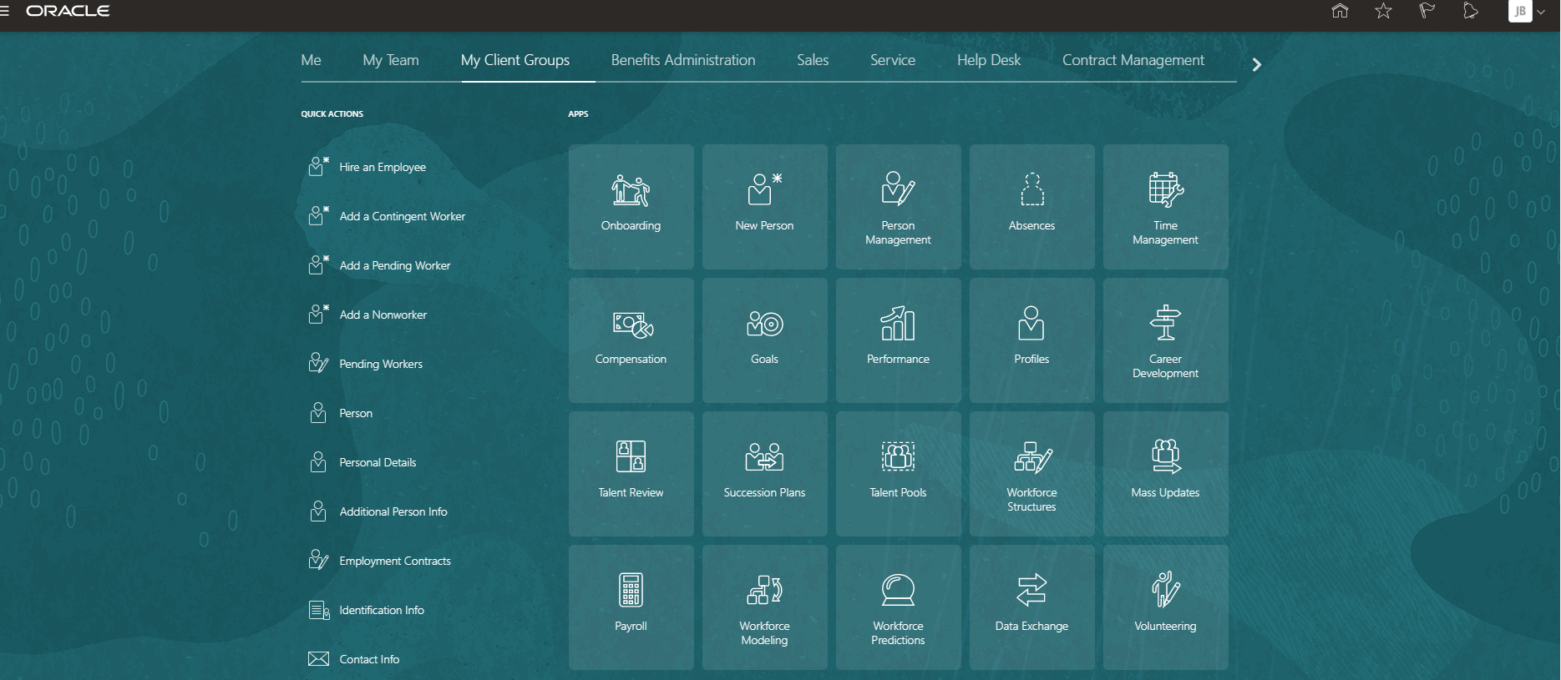
Payroll UI Navigation
To see payroll-related tasks and configurations,
1 Click My Client Groups
2 Click Payroll
2
Guided Learning Kit
Back

Slide 8
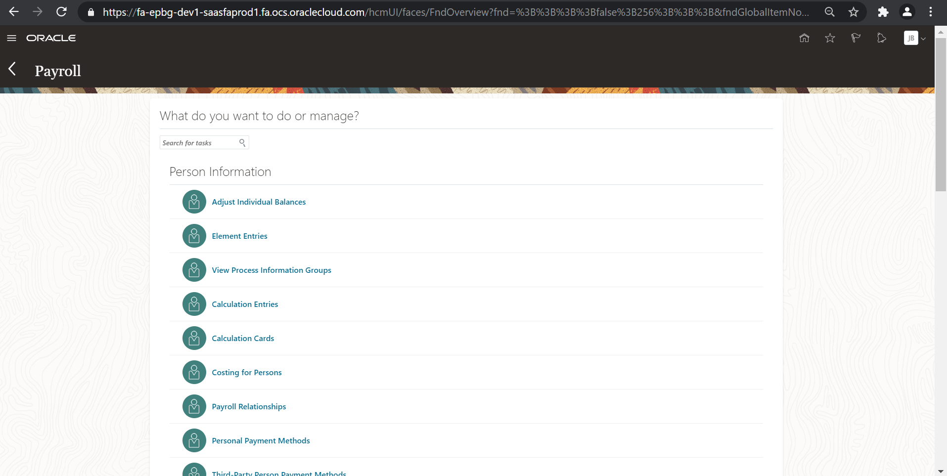
Payroll UI Navigation
There are 3 main areas/regions in the responsive UI pages of Payroll:
1. Person Information
2. Flow Submission and Results
3. Administration
1
Used to lookup employee related data and results
Scroll down this vertical bar to see the other payroll regions
Guided Learning Kit

Slide 9
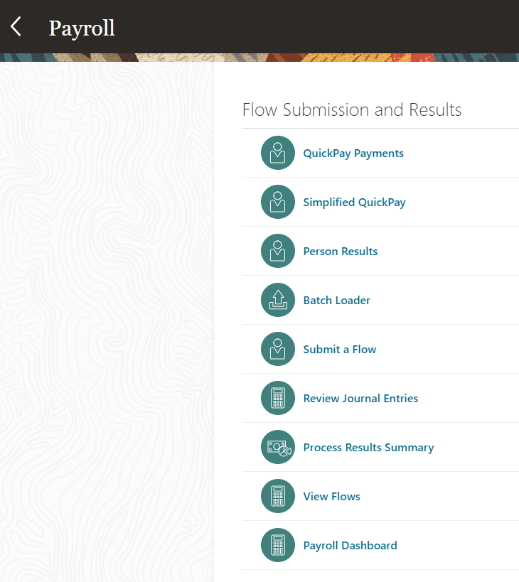
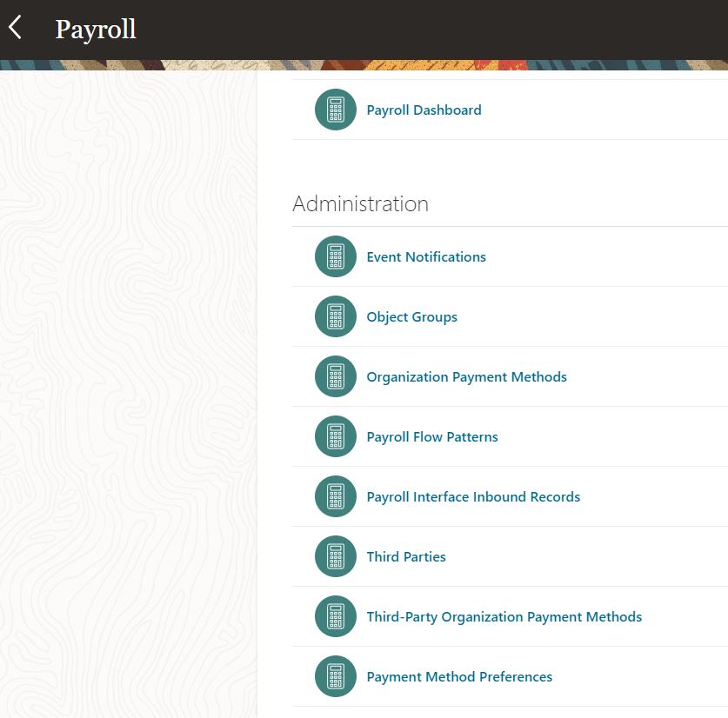
Payroll UI Navigation
2
Click < Payroll to go back to My Client Groups page
3
Used to lookup employee related data and results
Used to maintain and setup payroll related items
Guided Learning Kit
Next

Slide 10

Payroll UI Navigation
Click Home button
to back to Home page
Page redirects to the last clicked tab group e.g.
My Client Groups
Guided Learning Kit
Next

Slide 11
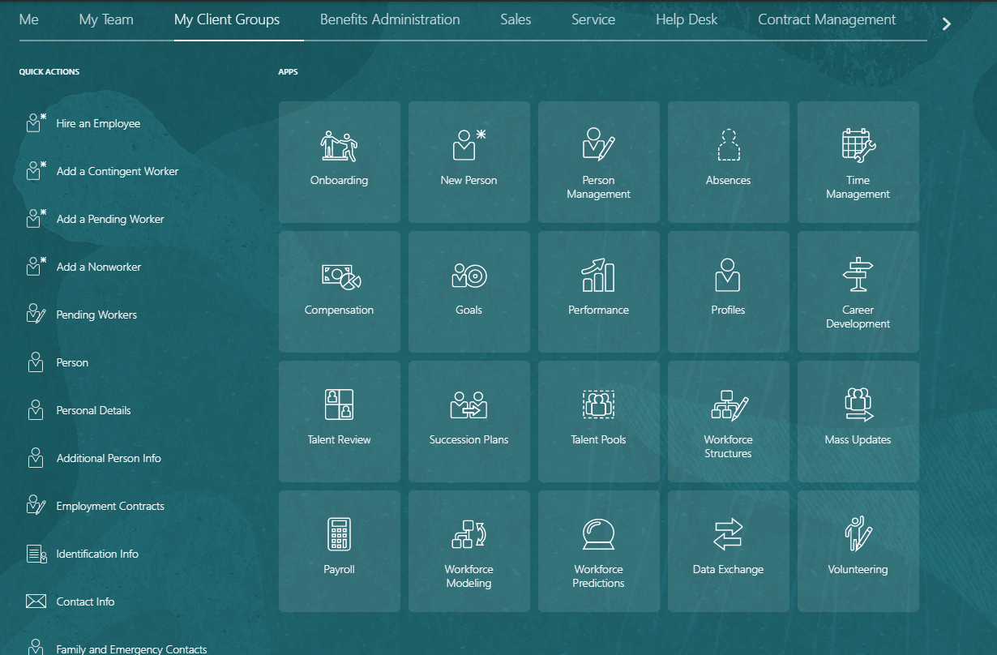
Payroll UI Navigation
Payroll Relationship
1
Enables you to enter information for a person in Oracle HCM Cloud that impacts their pay such as salary, compensation, time cards, and absences.
1 Click My Client Groups
Guided Learning Kit
Notes:
https://docs.oracle.com/en/cloud/saas/human-resources/20b/faigp/glossary.html
payroll relationship
Defines an association between a person and a payroll statutory unit based on payroll calculation and reporting requirements.
https://docs.oracle.com/en/cloud/saas/human-resources/20d/faagp/personal-payroll-info.html#FAAGP3716416

Slide 12
Payroll UI Navigation
Payroll Relationship
Enables you to enter information for a person in Oracle HCM Cloud that impacts their pay such as salary, compensation, time cards, and absences.
1 Click My Client Groups
2 Click Payroll
2
Guided Learning Kit

Slide 13
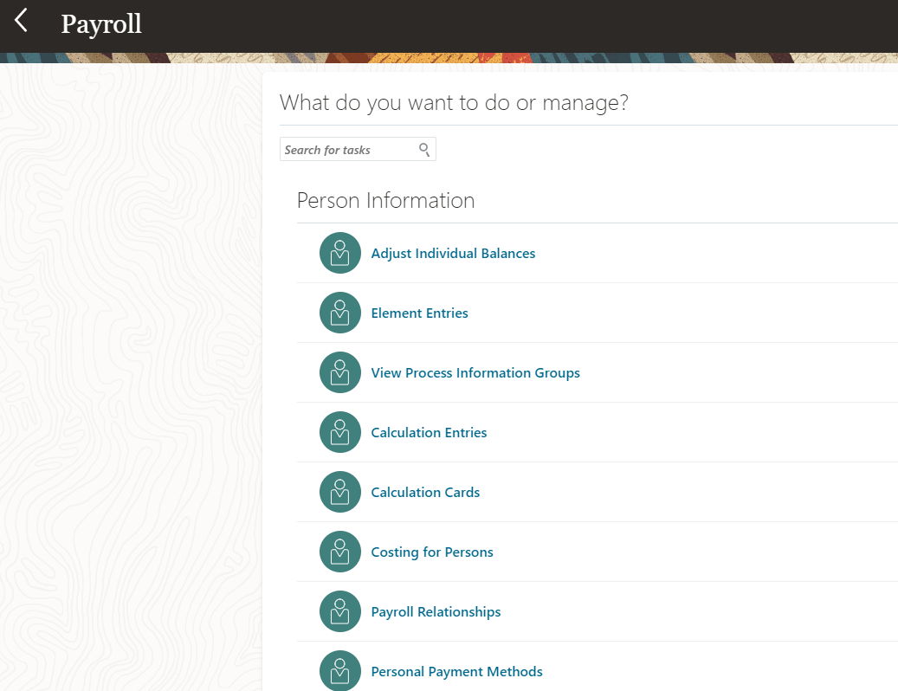
Payroll UI Navigation
Payroll Relationship
Enables you to enter information for a person in Oracle HCM Cloud that impacts their pay such as salary, compensation, time cards, and absences.
1 Click My Client Groups
2 Click Payroll
3 Click Payroll Relationships
3
Guided Learning Kit

Slide 14
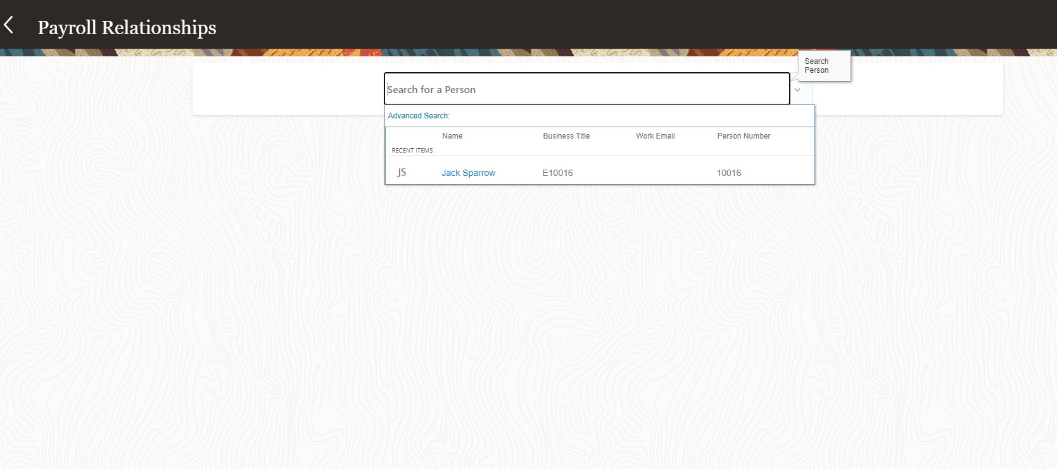
Payroll UI Navigation
Payroll Relationship
Enables you to enter information for a person in Oracle HCM Cloud that impacts their pay such as salary, compensation, time cards, and absences.
4
1 Click My Client Groups
2 Click Payroll
3 Click Payroll Relationship
4 Search and select a Person
Guided Learning Kit

Slide 15
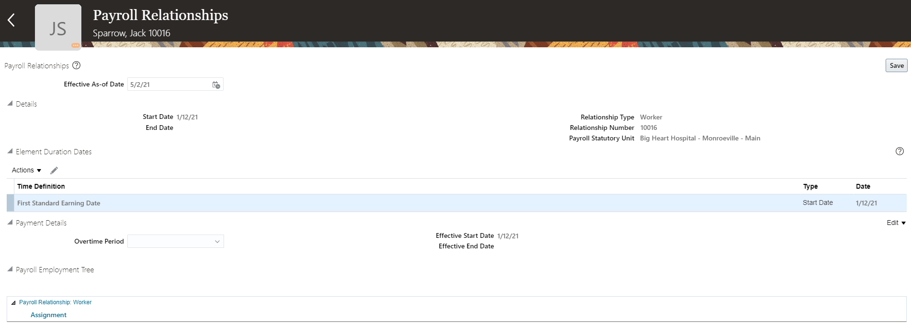
Payroll UI Navigation
Payroll Relationship
Enables you to enter information for a person in Oracle HCM Cloud that impacts their pay such as salary, compensation, time cards, and absences.
Payroll Relationship Number is an important information in processing payroll such processing a group of people via payroll relationship group.
1 Click My Client Groups
2 Click Payroll
3 Click Adjust individual Balance
4 Search and select a Person
5 Update payroll relationship details
5
Guided Learning Kit
Back to Catalog
Next

Slide 16
Payroll UI Navigation
Third-Party Person
Payment Methods
1
Create payment methods for payments to people who aren't on the payroll, such as payments to external organizations like State Disbursement Unit for use cases such as Child Support to a Former Spouse.
1 Click My Client Groups
Guided Learning Kit

Slide 17
Payroll UI Navigation
Third-Party Person
Payment Methods
Create payment methods for payments to people who aren't on the payroll, such as payments to external organizations like State Disbursement Unit for use cases such as Child Support to a Former Spouse.
1 Click My Client Groups
2 Click Payroll
2
Guided Learning Kit

Slide 18
Payroll UI Navigation
Third-Party Person
Payment Methods
Create payment methods for payments to people who aren't on the payroll, such as payments to external organizations like State Disbursement Unit for use cases such as Child Support to a Former Spouse.
1 Click My Client Groups
2 Click Payroll
3 Click Personal Payment Methods
3
Guided Learning Kit

Slide 19
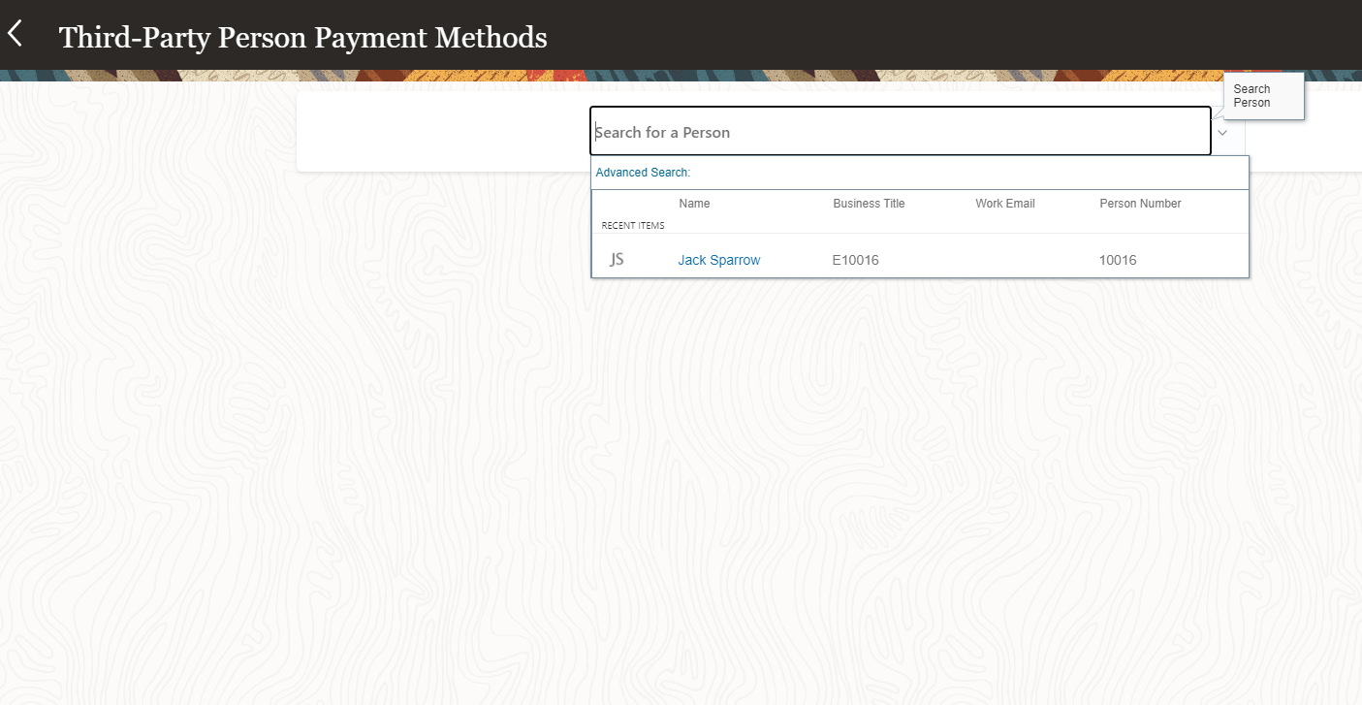
Payroll UI Navigation
Third-Party Person
Payment Methods
Create payment methods for payments to people who aren't on the payroll, such as payments to external organizations like State Disbursement Unit for use cases such as Child Support to a Former Spouse.
4
1 Click My Client Groups
2 Click Payroll
3 Click Personal Payment Methods
4 Search and select a Person
Guided Learning Kit

Slide 20
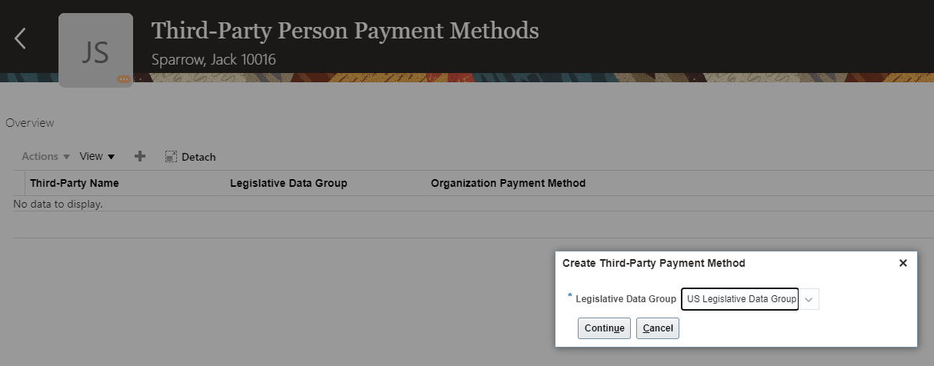
Payroll UI Navigation
Third-Party Person
Payment Methods
Create payment methods for payments to people who aren't on the payroll, such as payments to external organizations like State Disbursement Unit for use cases such as Child Support to a Former Spouse.
1 Click My Client Groups
2 Click Payroll
3 Click Personal Payment Methods
4 Search and select a Person
5 Enter LDG. Click Continue. Click + to add bank details
5
Guided Learning Kit

Slide 21
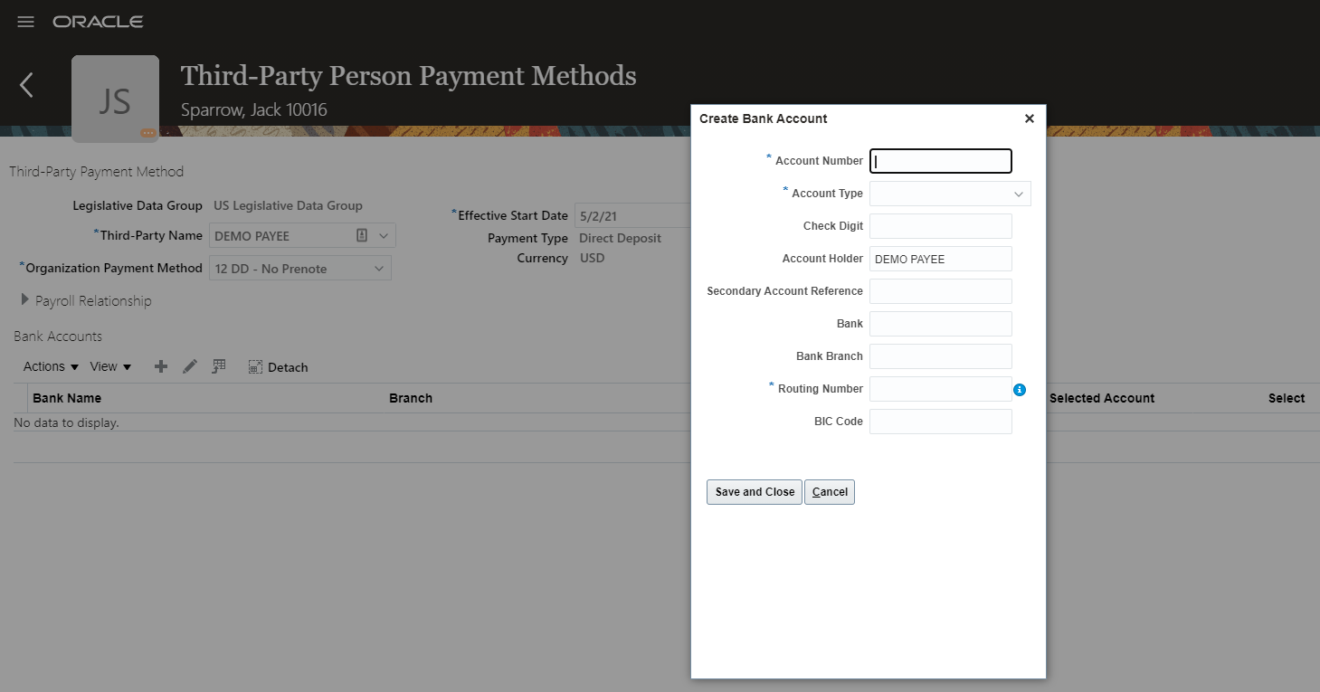
Payroll UI Navigation
Third-Party Person
Payment Methods
Create payment methods for payments to people who aren't on the payroll, such as payments to external organizations like State Disbursement Unit for use cases such as Child Support to a Former Spouse.
6
1 Click My Client Groups
2 Click Payroll
3 Click Personal Payment Methods
4 Search and select a Person
5 Enter LDG. Click Continue. Click + to add bank details
6 Enter bank details. Click Save and Close
Guided Learning Kit
Back to Catalog
Next

Slide 22
Payroll UI Navigation
Element Entries
1
You use element entries to capture earnings, deductions, absences, and basic benefit details for an employee assignment.
1 Click My Client Groups
Guided Learning Kit
Notes:
Element Entries
You use element entries to capture earnings, deductions, absences, and basic benefit details for an employee assignment. For example, you can create element entries for an employee's overtime hours or medical premium deduction amount.
https://docs.oracle.com/en/cloud/saas/human-resources/20b/faihm/loading-payroll-transactional-data.html#FAIHM3563277

Slide 23
Payroll UI Navigation
Element Entries
You use element entries to capture earnings, deductions, absences, and basic benefit details for an employee assignment.
1 Click My Client Groups
2 Click Payroll
2
Guided Learning Kit

Slide 24
Payroll UI Navigation
Element Entries
You use element entries to capture earnings, deductions, absences, and basic benefit details for an employee assignment.
1 Click My Client Groups
2 Click Payroll
3 Click Element Entries
3
Guided Learning Kit

Slide 25
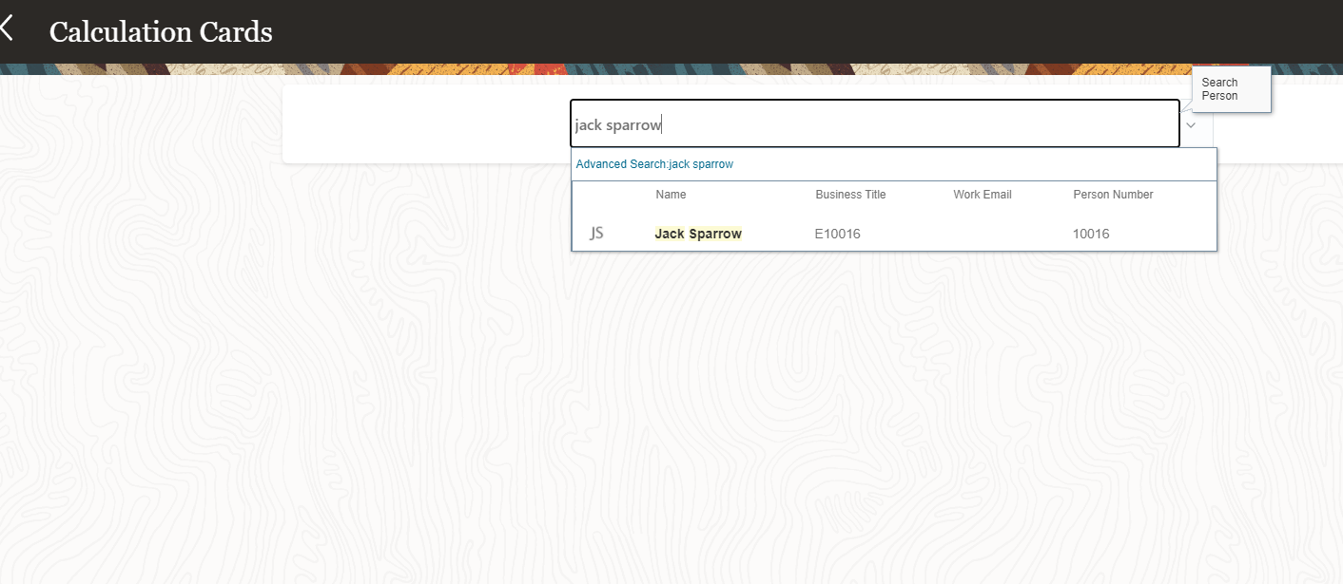
Payroll UI Navigation
Element Entries
You use element entries to capture earnings, deductions, absences, and basic benefit details for an employee assignment.
1 Click My Client Groups
2 Click Payroll
3 Click Personal Payment Methods
4 Search and select a Person
4
Guided Learning Kit

Slide 26
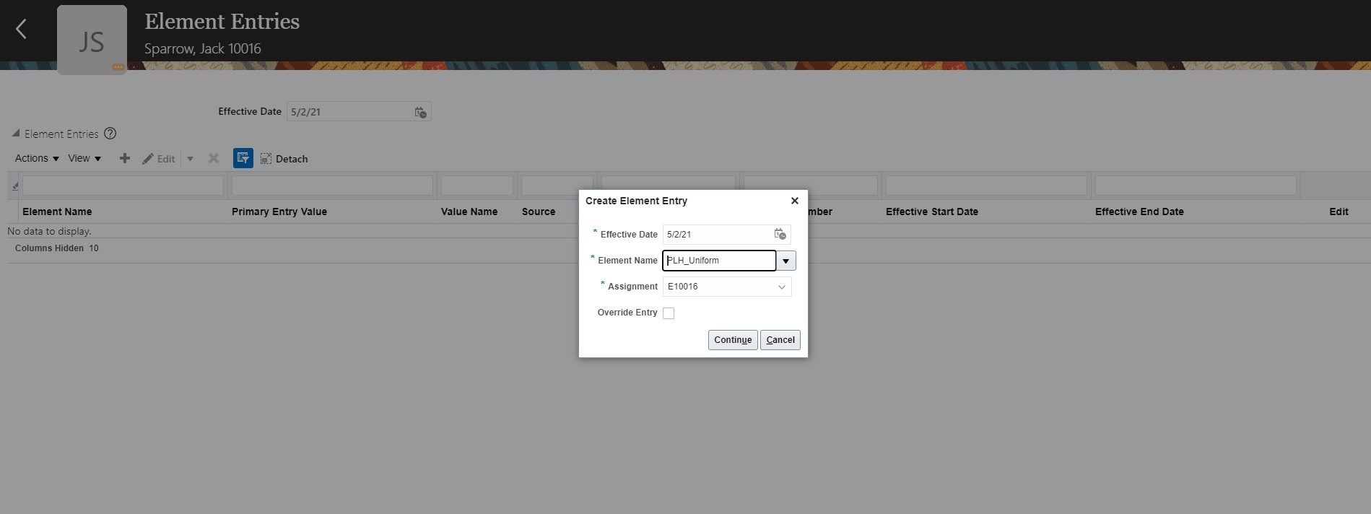
Payroll UI Navigation
Element Entries
You use element entries to capture earnings, deductions, absences, and basic benefit details for an employee assignment.
5
5
1 Click My Client Groups
2 Click Payroll
3 Click Personal Payment Methods
4 Search and select a Person
5 Click +. Select an Element Name. Select Assignment of the person. Click Continue.
Guided Learning Kit

Slide 27
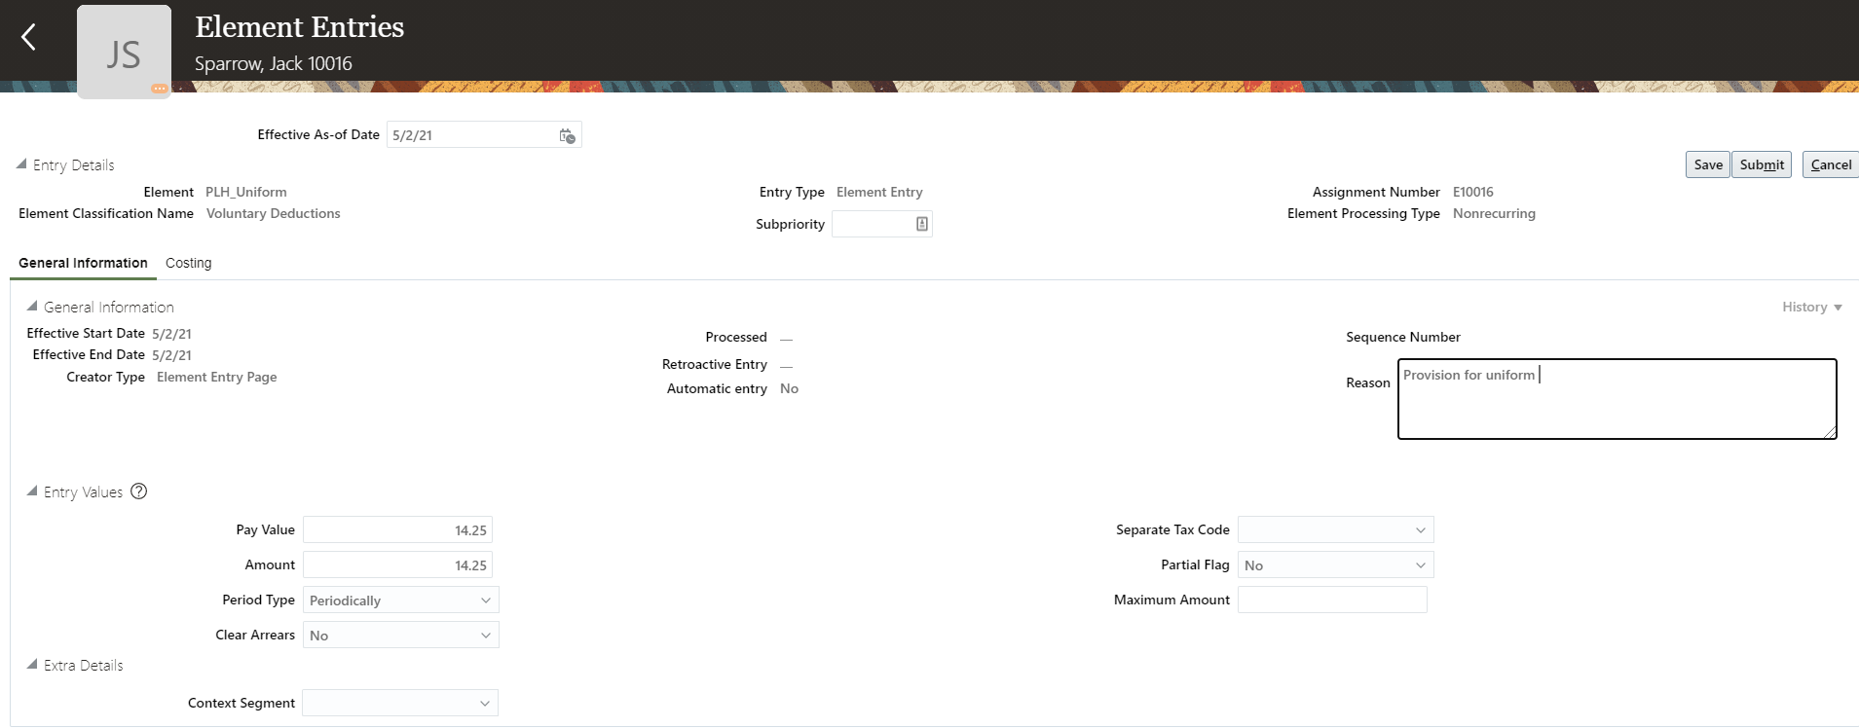
Payroll UI Navigation
Element Entries
You use element entries to capture earnings, deductions, absences, and basic benefit details for an employee assignment.
6
6
1 Click My Client Groups
2 Click Payroll
3 Click Personal Payment Methods
4 Search and select a Person
5 Click +. Select an Element Name. Select Assignment of the person. Click Continue.
6 Enter element entry values such as pay value, amount, reason, etc. Click Submit.
Guided Learning Kit
Back to Catalog
Next

Slide 28
Payroll UI Navigation
Calculation Cards
1
Capture info specific to a payroll relationship. Payroll runs use this info to calculate earnings and deductions.
1 Click My Client Groups
Guided Learning Kit
Notes:
https://docs.oracle.com/en/cloud/saas/human-resources/21a/faaus/maintain-personal-payroll-info.html#FAAUS2213693
Calculation Card Types
The types of calculation cards you can create and the type of info captured on a card can vary, including:
Absences
Benefits and pensions
Involuntary deductions
Statutory deductions
Time card entries

Slide 29
Payroll UI Navigation
Calculation Cards
Capture info specific to a payroll relationship. Payroll runs use this info to calculate earnings and deductions.
1 Click My Client Groups
2 Click Payroll
2
Guided Learning Kit

Slide 30
Payroll UI Navigation
Calculation Cards
Capture info specific to a payroll relationship. Payroll runs use this info to calculate earnings and deductions.
1 Click My Client Groups
2 Click Payroll
3 Click Calculation Cards
3
Guided Learning Kit

Slide 31
Payroll UI Navigation
Calculation Cards
Capture info specific to a payroll relationship. Payroll runs use this info to calculate earnings and deductions.
1 Click My Client Groups
2 Click Payroll
3 Click Calculation Cards
4 Search and select a Person
4
Guided Learning Kit

Slide 32
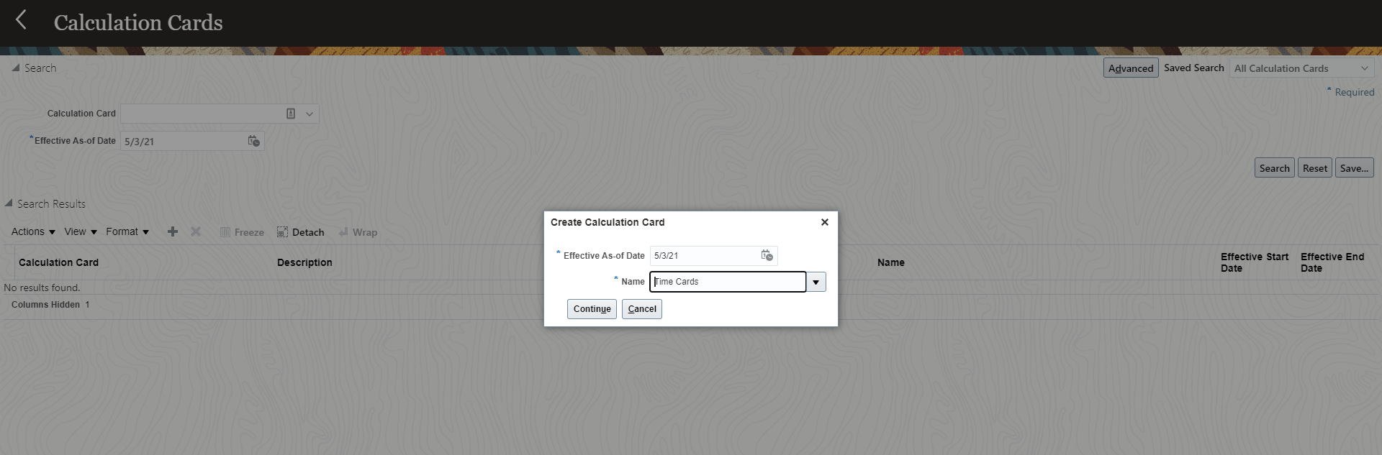
Payroll UI Navigation
Calculation Cards
Capture info specific to a payroll relationship. Payroll runs use this info to calculate earnings and deductions.
1 Click My Client Groups
2 Click Payroll
3 Click Calculation Cards
4 Search and select a Person
5 Create Calculation Card. Click Continue.
5
Guided Learning Kit

Slide 33
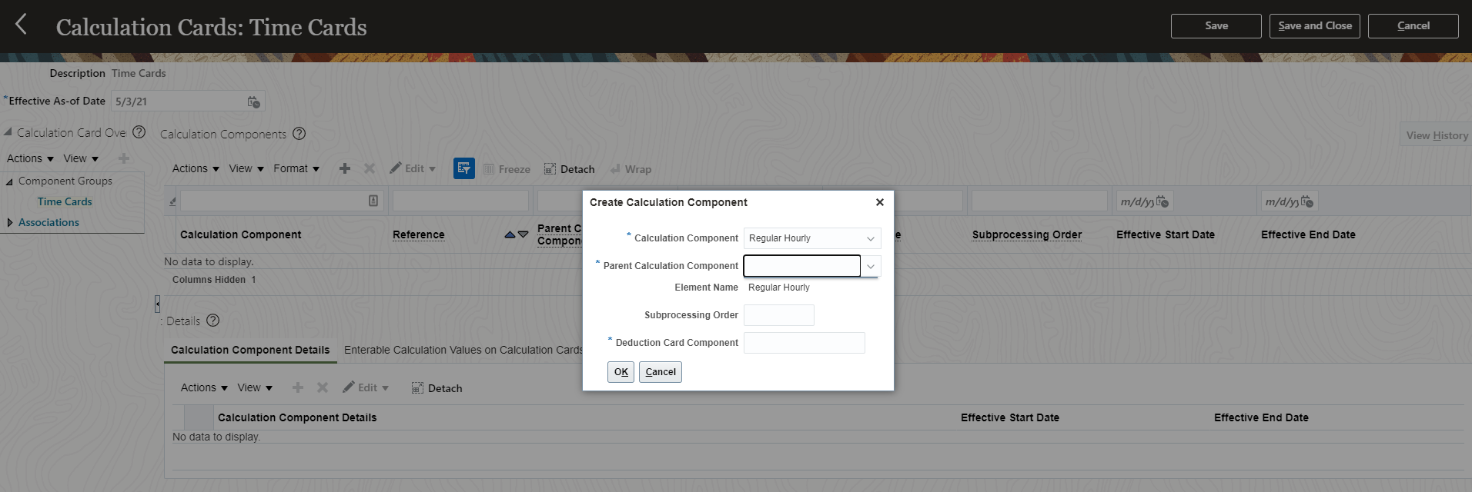
Payroll UI Navigation
Calculation Cards
Capture info specific to a payroll relationship. Payroll runs use this info to calculate earnings and deductions.
6
1 Click My Client Groups
2 Click Payroll
3 Click Calculation Cards
4 Search and select a Person
5 Create Calculation Card
6 Define the Calculation Card, Calculation Component, Component Details and Enterable Calculation Values
Guided Learning Kit
Back to Catalog
Next

Slide 34
Payroll UI Navigation
Adjust Individual Balance
1
You can adjust balances by using adjustment element entries to individuals to be processed in the payroll run, or use the Balance Adjustment process.
1 Click My Client Groups
Guided Learning Kit
Notes:
https://docs.oracle.com/en/cloud/saas/human-resources/21a/faagp/calculation-entries.html#FAAGP4181745

Slide 35
Payroll UI Navigation
Adjust Individual Balance
You can adjust balances by using adjustment element entries to individuals to be processed in the payroll run, or use the Balance Adjustment process.
1 Click My Client Groups
2 Click Payroll
2
Guided Learning Kit

Slide 36
Payroll UI Navigation
Adjust Individual Balance
You can adjust balances by using adjustment element entries to individuals to be processed in the payroll run, or use the Balance Adjustment process.
3
1 Click My Client Groups
2 Click Payroll
3 Click Adjust individual Balance
Guided Learning Kit

Slide 37
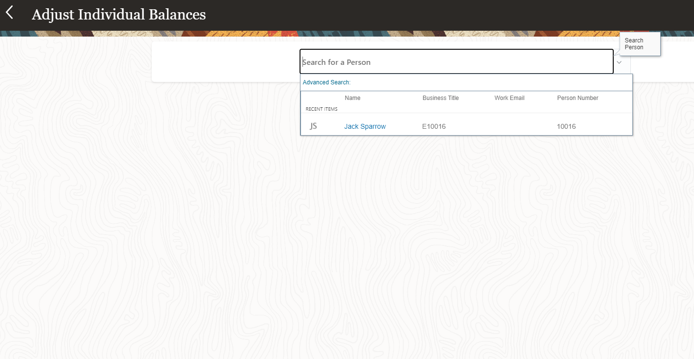
Payroll UI Navigation
Adjust Individual Balance
You can adjust balances by using adjustment element entries to individuals to be processed in the payroll run, or use the Balance Adjustment process.
4
1 Click My Client Groups
2 Click Payroll
3 Click Adjust individual Balance
4 Search and select a Person
Guided Learning Kit

Slide 38
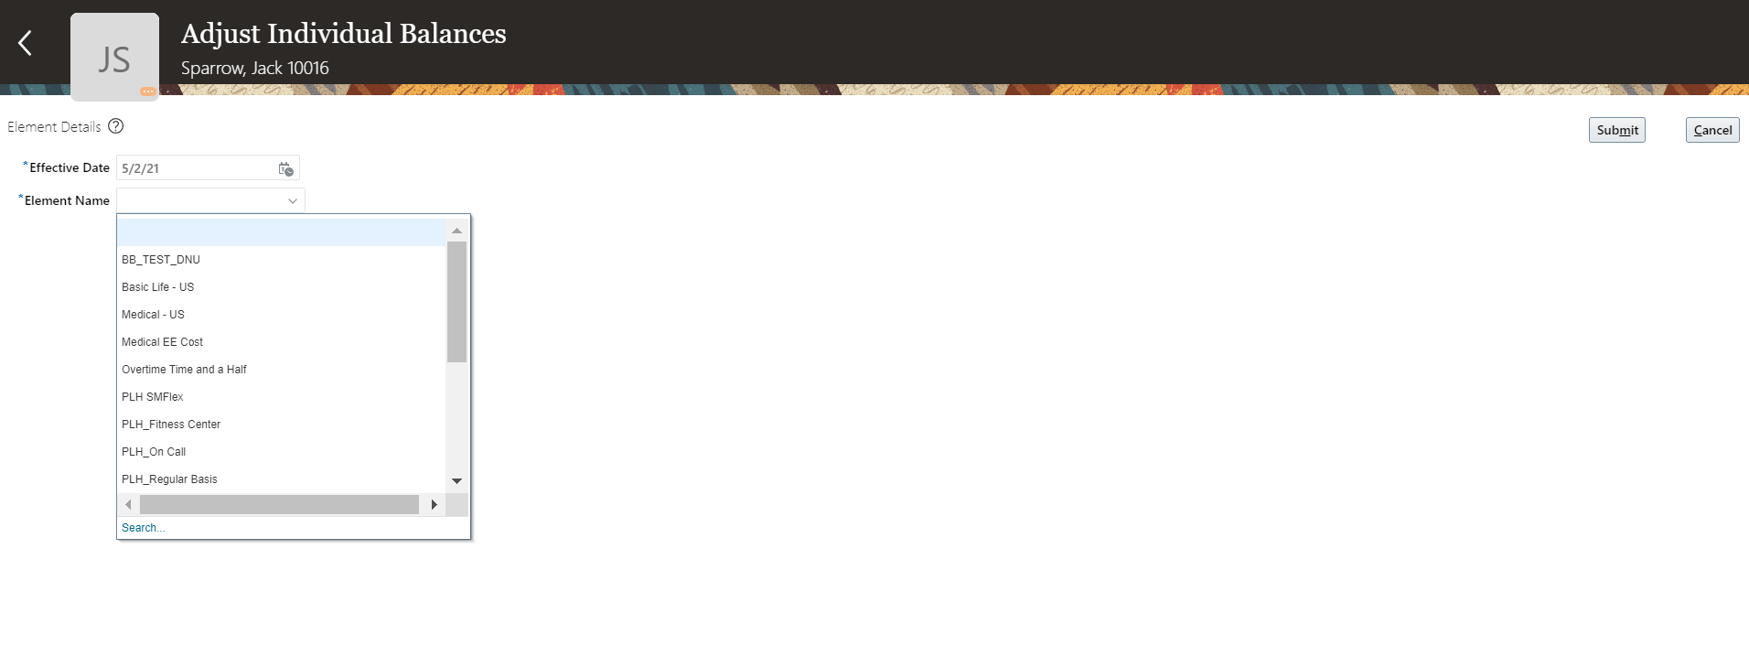
Payroll UI Navigation
Adjust Individual Balance
You can adjust balances by using adjustment element entries to individuals to be processed in the payroll run, or use the Balance Adjustment process.
1 Click My Client Groups
2 Click Payroll
3 Click Adjust individual Balance
4 Search and select a Person
5 Select an element name to adjust balance
5
Guided Learning Kit

Slide 39
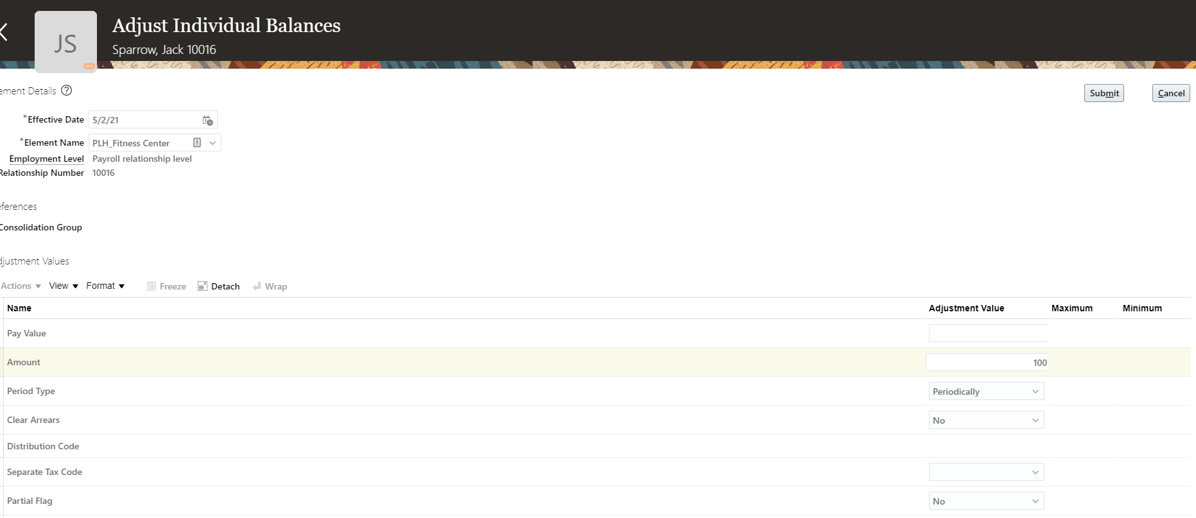
Payroll UI Navigation
Adjust Individual Balance
You can adjust balances by using adjustment element entries to individuals to be processed in the payroll run, or use the Balance Adjustment process.
6
1 Click My Client Groups
2 Click Payroll
3 Click Adjust individual Balance
4 Search and select a Person
5 Select an element name to adjust balance
6 Enter Adjustment Value. Click Submit.
6
Enter a balance adjustment by adjusting the entry value of an element that feeds the balance. Typically, you adjust the primary output value, but you can adjust other entry values too. When you submit an adjustment, the values entered become processed run results.
Guided Learning Kit
Back to Catalog
Next

Slide 40
Payroll UI Navigation
Simplified QuickPay
1
Includes tasks for calculating payroll run results. You can use this to process QuickPay immediately after updating a person's element, time card, or absence entries
1 Click My Client Groups
Guided Learning Kit
Notes:
https://docs.oracle.com/en/cloud/saas/human-resources/21a/faupf/quickpay-flows.html#FAUPF773683
Simplified QuickPay task
Process all QuickPay actions from a single page
Automatically populate parameters based on the effective date
Process one or more QuickPay flows
Process QuickPay immediately after updating a person's element, time card, or absence entries

Slide 41
Payroll UI Navigation
Simplified QuickPay
Includes tasks for calculating payroll run results. You can use this to process QuickPay immediately after updating a person's element, time card, or absence entries
1 Click My Client Groups
2 Click Payroll
2
Guided Learning Kit

Slide 42
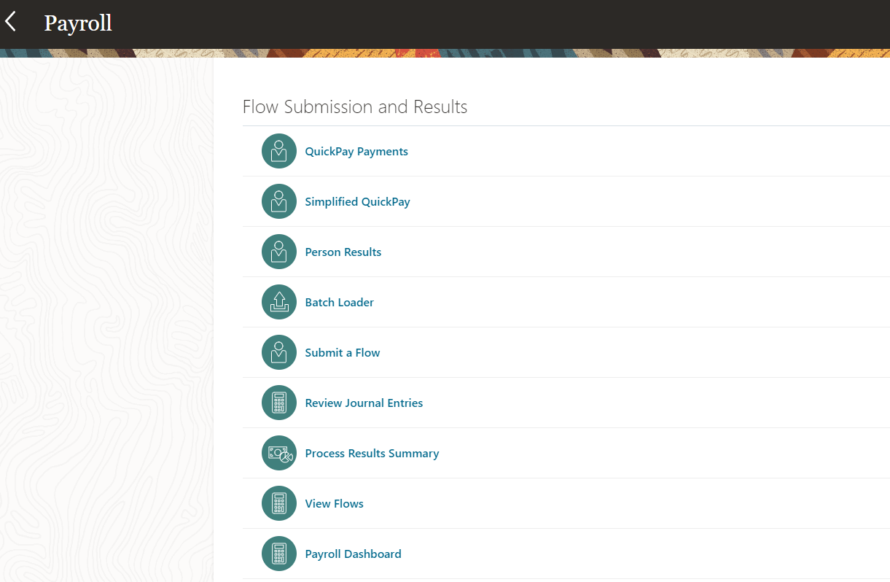
Payroll UI Navigation
Simplified QuickPay
Includes tasks for calculating payroll run results. You can use this to process QuickPay immediately after updating a person's element, time card, or absence entries
3
1 Click My Client Groups
2 Click Payroll
3 Click Simplified QuickPay
Guided Learning Kit

Slide 43
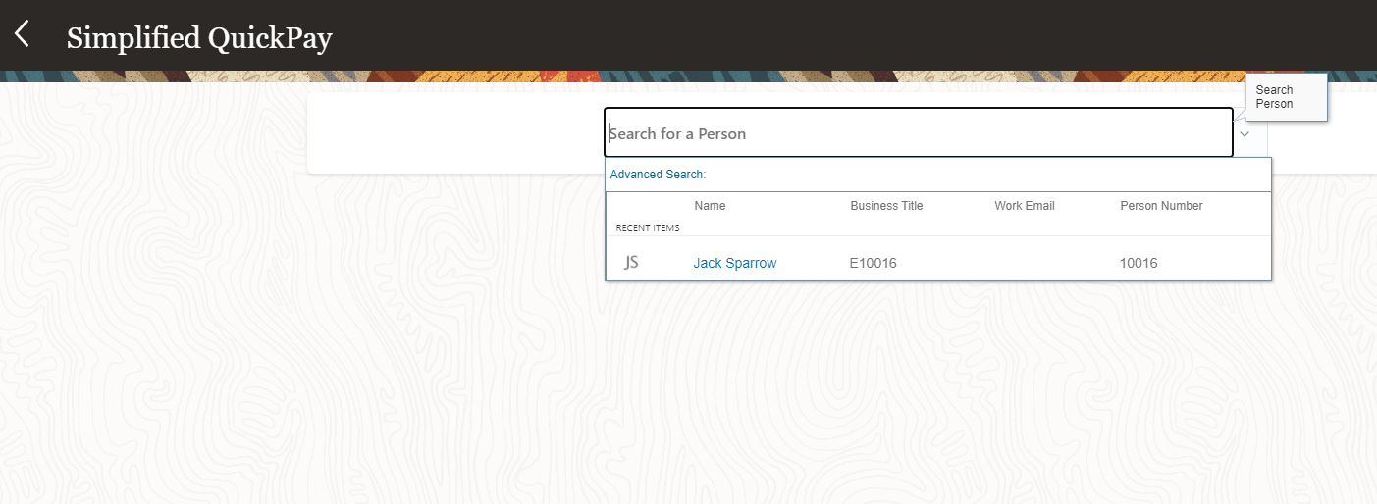
Payroll UI Navigation
Simplified QuickPay
Includes tasks for calculating payroll run results. You can use this to process QuickPay immediately after updating a person's element, time card, or absence entries
4
1 Click My Client Groups
2 Click Payroll
3 Click Simplified QuickPay
4 Search and select a Person
Guided Learning Kit

Slide 44
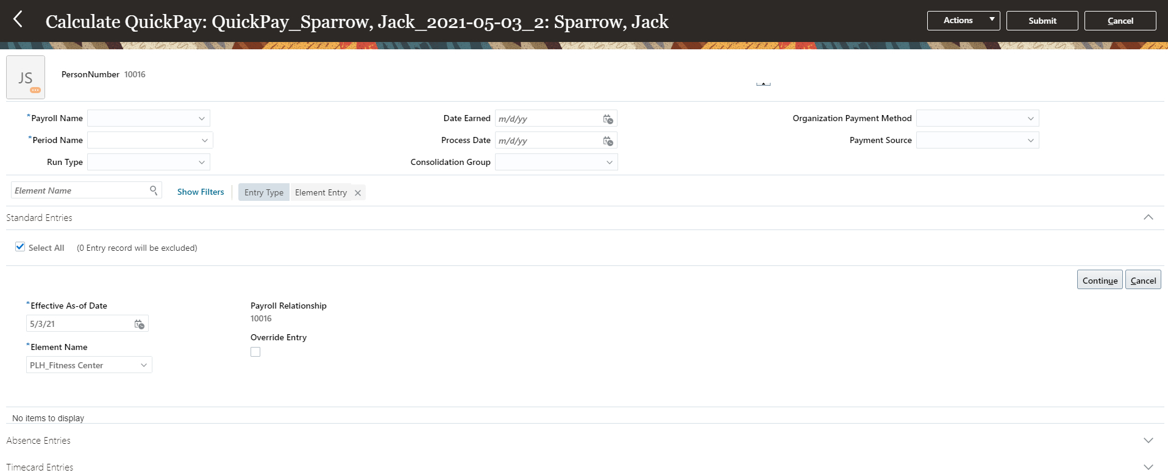
Payroll UI Navigation
Simplified QuickPay
Includes tasks for calculating payroll run results. You can use this to process QuickPay immediately after updating a person's element, time card, or absence entries
5
1 Click My Client Groups
2 Click Payroll
3 Click Simplified QuickPay
4 Search and select a Person
5 Enter QuickPay details such as payroll name, period name, etc. Review the eligible element entries or click the Add button to add element entries manually.
Guided Learning Kit
Back to Catalog
Next

Slide 45
Payroll UI Navigation
Person Results
1
Shows the results for all run types you processed during the payroll run of a person.
1 Click My Client Groups
Guided Learning Kit
Notes:
https://docs.oracle.com/en/cloud/saas/human-resources/20d/faaus/view-and-verify-run-results.html#FAAUS3891181

Slide 46
Payroll UI Navigation
Person Results
Shows the results for all run types you processed during the payroll run of a person.
1 Click My Client Groups
2 Click Payroll
2
Guided Learning Kit

Slide 47
Payroll UI Navigation
Person Results
Shows the results for all run types you processed during the payroll run of a person.
1 Click My Client Groups
2 Click Payroll
3 Click Person Results
3
Guided Learning Kit

Slide 48
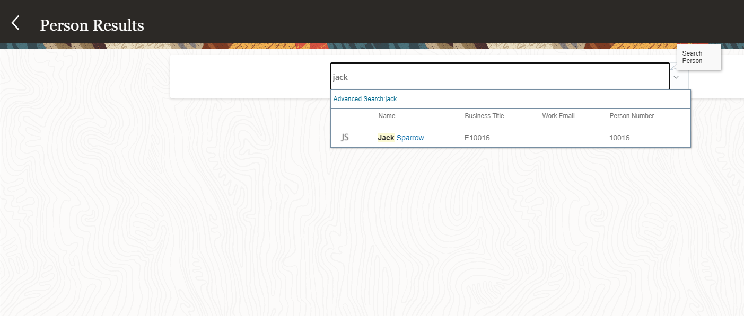
Payroll UI Navigation
Person Results
Shows the results for all run types you processed during the payroll run of a person.
1 Click My Client Groups
2 Click Payroll
3 Click Simplified QuickPay
4 Search and select a Person
4
Guided Learning Kit

Slide 49
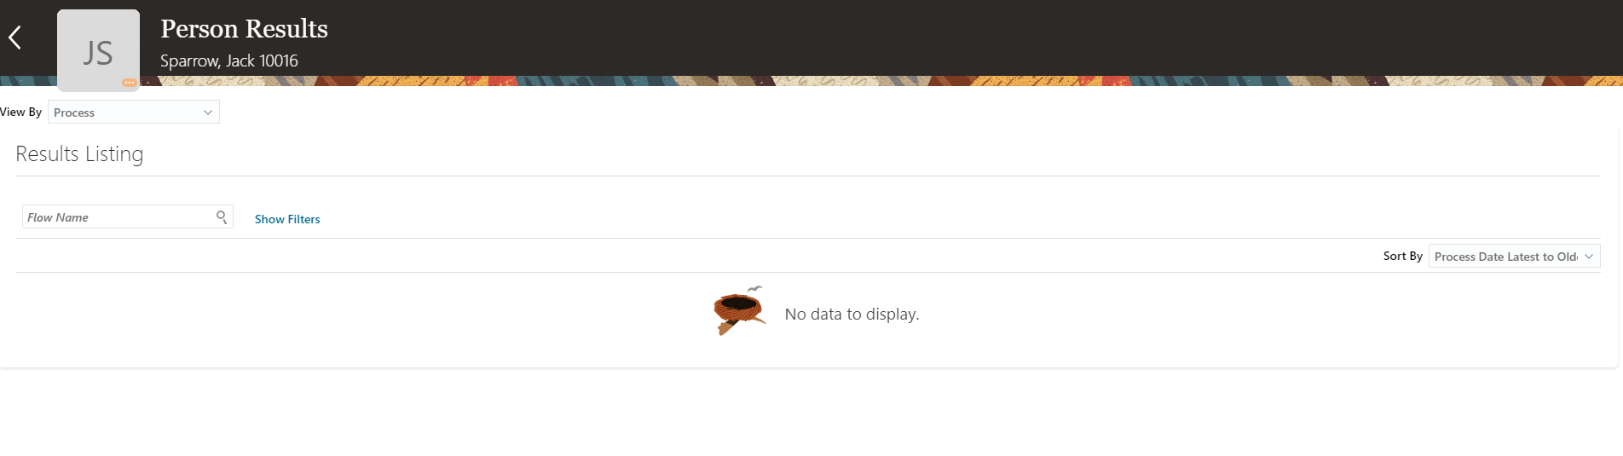
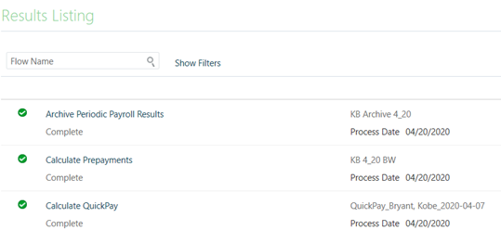
Payroll UI Navigation
Person Results
Shows the results for all run types you processed during the payroll run of a person.
1 Click My Client Groups
2 Click Payroll
3 Click Simplified QuickPay
4 Search and select a Person
5 Search and view payroll process results associated with the person
5
Guided Learning Kit

Slide 50
Payroll UI Navigation
Person Results
Shows the results for all run types you processed during the payroll run of a person.
1 Click My Client Groups
2 Click Payroll
3 Click Simplified QuickPay
4 Search and select a Person
5 Search and view payroll process results associated with the person
6 Click the person result process links to review details such as statement of earnings, Prakash, or costing info.
6
Guided Learning Kit
Back to Catalog
Next

Slide 51
Payroll UI Navigation
Submit a Flow
1
Allows you to submit a flows such as Process e.g. Calculate Payroll
Report, Data Load or Task Flow e.g. Payroll Cycle
1 Click My Client Groups
Guided Learning Kit
Notes:
https://docs.oracle.com/en/cloud/saas/human-resources/21a/faupf/payroll-flow-patterns.html#FAUPF2315796
Submit a Flow
Watch video
Use the Submit a Flow page to submit a flow. You can submit these flow types from the flow submission page:
Process, such as Calculate Payroll. This type of flow has a single task.
Report, such as the Run Payroll Activity Report. This type of flow has a single task.
Data Load, such as a task that loads payroll setup objects into the Oracle HCM Cloud application stage tables.
Task Flow, such as the Payroll Cycle, which lists the payroll tasks to complete for a payroll period in a best practice flow.
Navigate to My Client Groups > Payroll from your Home page and click Submit a Flow under the Flow Submission and Results section. The Submit a Flow page opens.
What You Can Do on the Submit a Flow Page
Search on the flow pattern name or use the filters on this page to select the flow pattern you want to submit. Use the Show Filters field to view the fields on which you can filter.
Select an LDG to narrow your search to flows specific to the selected LDG.
After you search and select the flow, the Submit a Flow page opens. Follow these steps to submit the flow from this page:
Enter a name for the instance of the flow that you're about to submit. For example, if you're submitting the Calculate Payroll flow pattern for a weekly payroll run, enter a flow name that uniquely identifies the payroll run, such as 'Weekly Payroll 10/10/19'.
Note: It's best practice to enter a name that includes the payroll period, so that it's easier to identify later.
Use the Parameters section to enter the flow parameters, including, process date, run type, and payroll. The flow pattern controls which parameters are available on the page.
Use the Schedule section to schedule the flow. You can use a predefined schedule if available or select 'As soon as possible' to run the flow as soon as you submit the flow.
Use the Linked Flows section to link another flow to your current flow, or link your current flow to another flow. Your data security access controls which flows you can view and submit, and therefore, which flows you can connect. For more information, refer to the 'Examples of Linking Flows' topic in the Help Center.
If you have enabled logging, a message appears on the page to indicate that logging is enabled. Before submission of the flow, either disable logging of the defaulted group or select another process configuration group that doesn't have logging enabled. For more information, refer to 'Enable Logging for Payroll Flows ' topic in the Help Center.
When you submit the flow, you're taken to the Checklist page. Monitor and manage the tasks within the flow from the Checklist page.

Slide 52
Payroll UI Navigation
Submit a Flow
Allows you to submit a flows such as Process e.g. Calculate Payroll
Report, Data Load or Task Flow e.g. Payroll Cycle
1 Click My Client Groups
2 Click Payroll
2
Guided Learning Kit

Slide 53
Payroll UI Navigation
Submit a Flow
Allows you to submit a flows such as Process e.g. Calculate Payroll
Report, Data Load or Task Flow e.g. Payroll Cycle
1 Click My Client Groups
2 Click Payroll
3 Click Submit a Flow
3
Guided Learning Kit

Slide 54
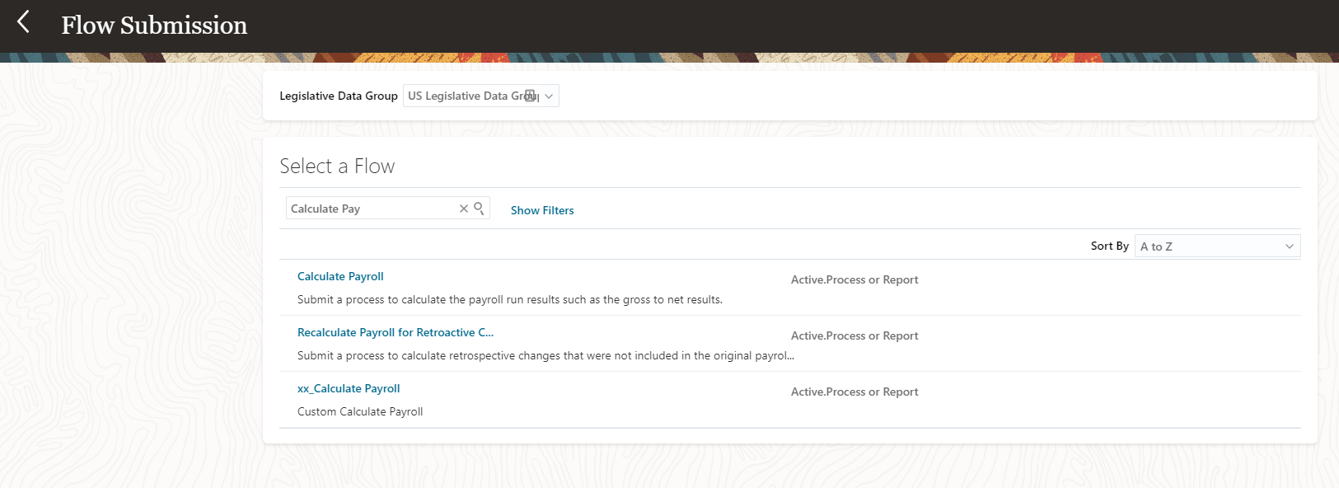
Payroll UI Navigation
Submit a Flow
Allows you to submit a flows such as Process e.g. Calculate Payroll
Report, Data Load or Task Flow e.g. Payroll Cycle
1 Click My Client Groups
2 Click Payroll
3 Click Submit a Flow
4 Select an LDG e.g. US LDG. Search or select a Flow Name to run e.g. Recalculate Payroll%
4
Guided Learning Kit

Slide 55
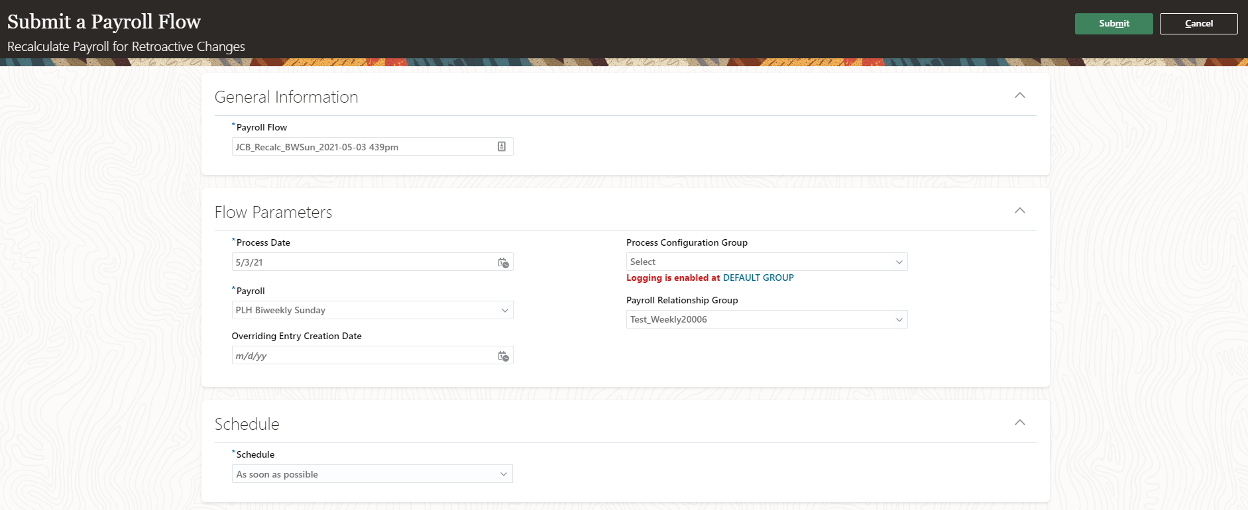
Payroll UI Navigation
Submit a Flow
Allows you to submit a flows such as Process e.g. Calculate Payroll
Report, Data Load or Task Flow e.g. Payroll Cycle
5
1 Click My Client Groups
2 Click Payroll
3 Click Submit a Flow
4 Select an LDG e.g. US LDG. Search or select a Flow Name to run.
5 Enter flow parameters. Click Submit.
Guided Learning Kit
Back to Catalog
Next

Slide 56
Payroll UI Navigation
View Flows
1
View the status of submitted flows that are in progress and require your attention. It overall status of a flow, and each task within the flow can have a different status.
1 Click My Client Groups
Guided Learning Kit
Notes:
https://docs.oracle.com/en/cloud/saas/human-resources/20b/faupf/submit-and-monitor-flows.html#FAUPF3966286
View Flows
Use the View Flows page to view the status of submitted flows that are in progress and require your attention. The flows on this page display a high-level status of the flow.
To open the View Flows page, navigate to My Client Groups > Payroll from your Home page and click View Flows under the Flow Submission and Results section.
The View Flows page displays the overall status of a flow, and each task within the flow can have a different status.
For this reason, the View Flows page displays the flow status based on the flow hierarchy. The flow hierarchy is used to display a flow status based on the task within the flow that has the most critical status.
What You Can Do on the View Flows Page
Search on the flow pattern name or use the filters on this page to select the flow pattern you want to submit. Use the Show Filters field to view the fields on which you can filter.
You can filter on a wide range of filter choices such as Legislative Data Group, payroll, submission date, submitted by, flow type, flow patterns, flow status, and so on.
Use the Submission date to filter and view at a glance active flows submitted:
On the same day
In the last seven days
Within a date range
After you search and select the flow, you can perform these tasks on the View Flows page:
Monitor and track all tasks within the flow.
Monitor issues with the flow such as processes in error, and review processes that are running slower than average.
Select a task to go to the Checklist page or Process Results page.

Slide 57
Payroll UI Navigation
View Flows
View the status of submitted flows that are in progress and require your attention. It overall status of a flow, and each task within the flow can have a different status.
1 Click My Client Groups
2 Click Payroll
2
Guided Learning Kit

Slide 58
Payroll UI Navigation
View Flows
View the status of submitted flows that are in progress and require your attention. It overall status of a flow, and each task within the flow can have a different status.
1 Click My Client Groups
2 Click Payroll
3 Click View Flows
3
Guided Learning Kit

Slide 59
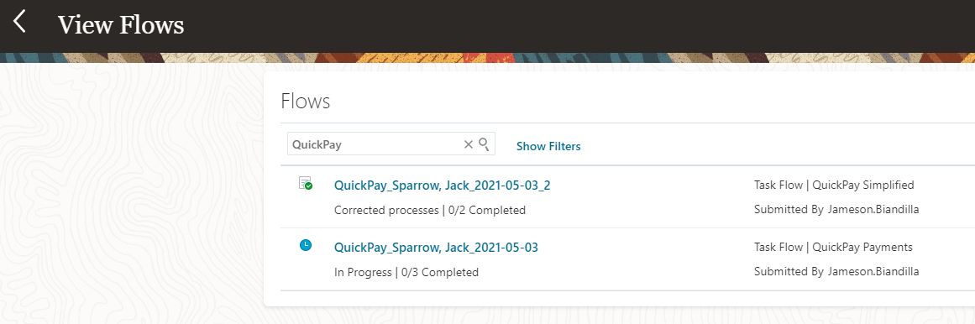
Payroll UI Navigation
View Flows
View the status of submitted flows that are in progress and require your attention. It overall status of a flow, and each task within the flow can have a different status.
4
1 Click My Client Groups
2 Click Payroll
3 Click View Flows
4 Search or browse through submitted flows. Click a payroll flow e.g. QuickPay%
Guided Learning Kit

Slide 60
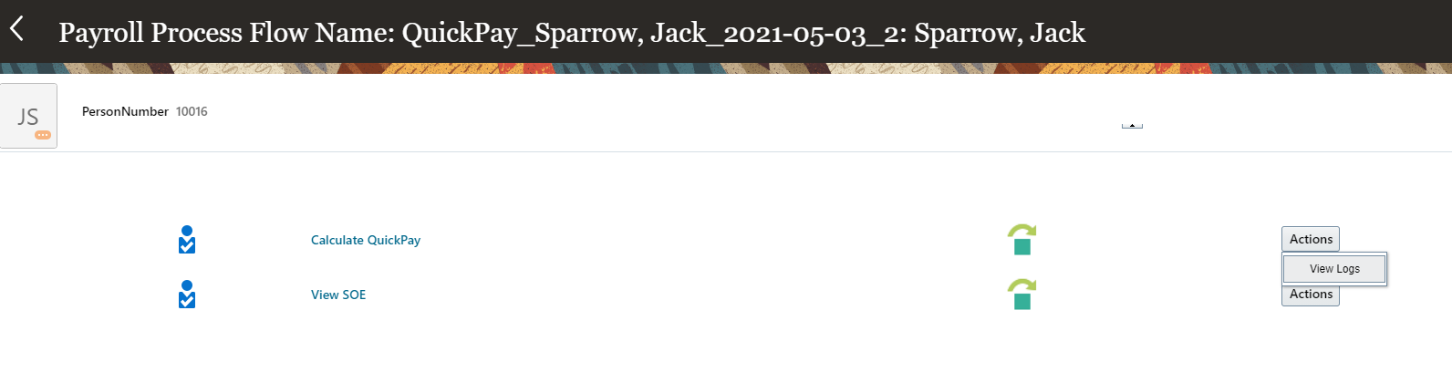
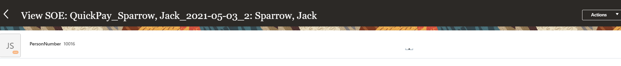
Payroll UI Navigation
View Flows
View the status of submitted flows that are in progress and require your attention. It overall status of a flow, and each task within the flow can have a different status.
1 Click My Client Groups
2 Click Payroll
3 Click View Flows
4 Search or browse through submitted flows. Click a payroll flow e.g. QuickPay%
5. Click on a flow subprocess e.g. View SOE.
Review the statement of earnings.
4
Guided Learning Kit
Back to Catalog

